Slide 1

Expand course9-Tracking
Yahboom
Yahboom Omibox Tutorial

Slide 2
1
2
3
4
5
6
Learning
goals
Experimental
principle
Combine
blocks
Experimental
phenomena
Preparation
Search for
blocks
程序编程
Tencent
Yahboom Omibox Tutorial

Slide 3
1
Preparation-1
1. The position of the Tracking sensor in the robot car
2. Learn to understand the principle of Tracking
3. Learn how to use Tracking sensor graphically program building blocks.
Yahboom Omibox Tutorial

Slide 4
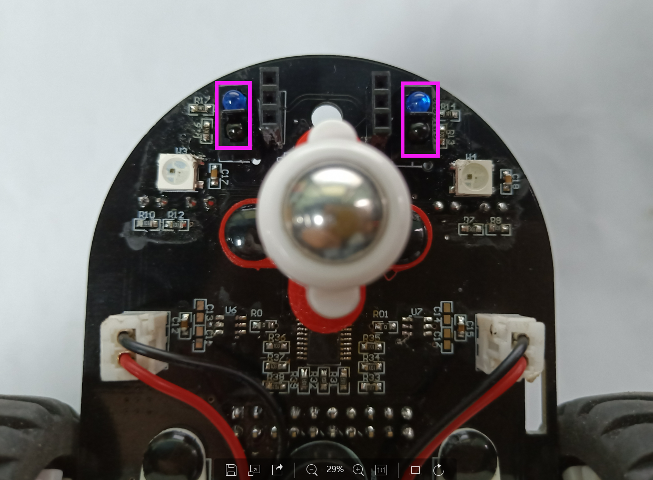
1
Preparation-2
As shown in the above picture, We circled the Tracking sensor with two purple wire frame. We can control them by programming.
Yahboom Omibox Tutorial

Slide 5
2
Learning goals
In this lesson we will learn how to complete the tracking function of the robot car by programming.
Yahboom Omibox Tutorial

Slide 6
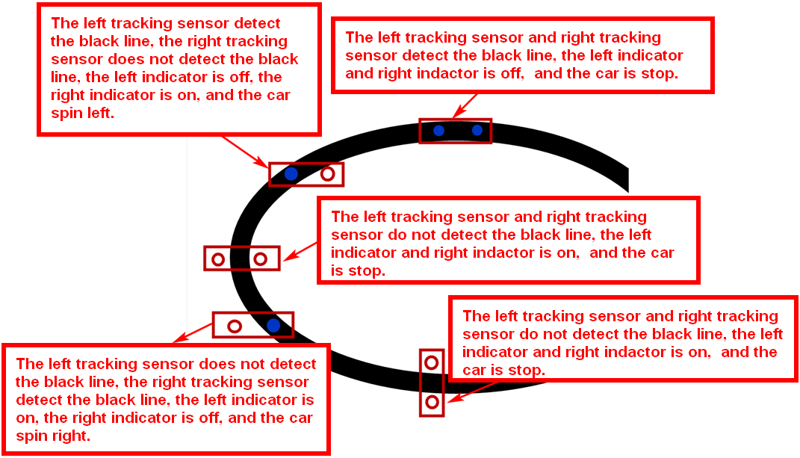
3
Experimental principle
The basic principle of the tracking sensor is to use the reflective nature of the object. Our experiment is to tracking the black line. When the infrared light is emitted to the black line, it will be absorbed by the black line. When the infrared light is emitted to the other color line, it will reflected to the infrared receiver tube.
When the tracking module of the robot car detects a black line, the indicator light is off, and the indicator light is on when a white (no black) object is detected. We write the corresponding code to complete the tracking function according to this point.
Yahboom Omibox Tutorial

Slide 7
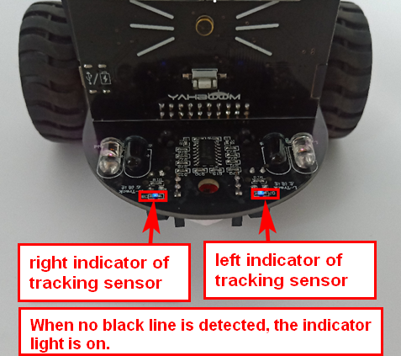
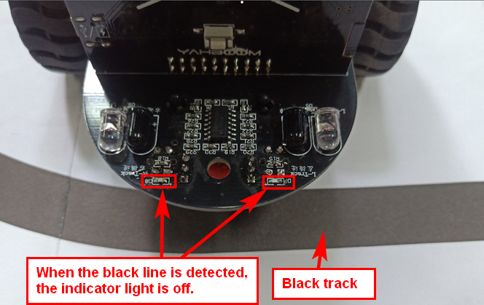
3
Experimental principle
Yahboom Omibox Tutorial

Slide 8
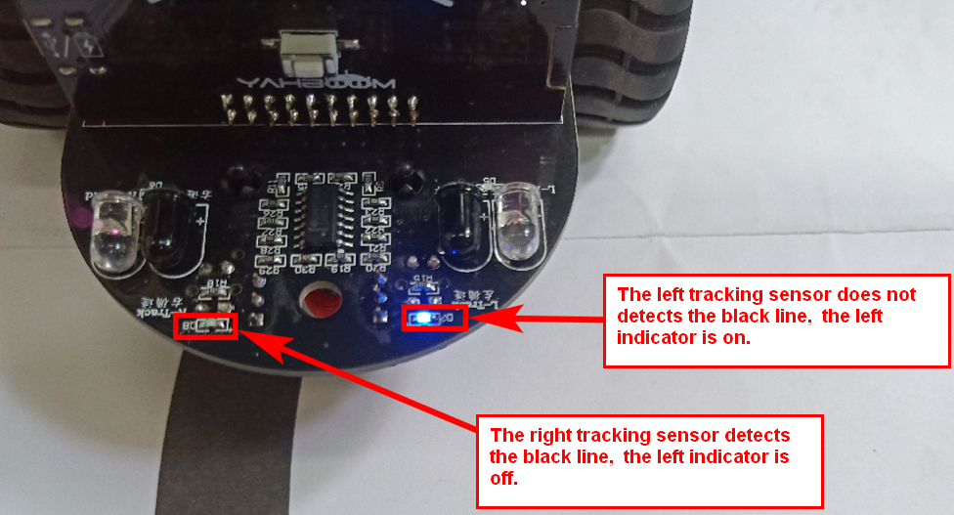
3
Experimental principle
Yahboom Omibox Tutorial

Slide 9
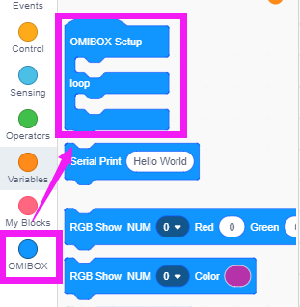
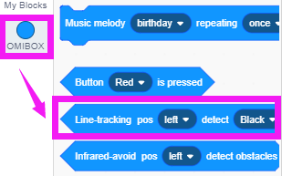
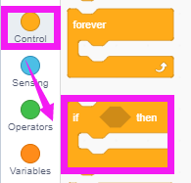
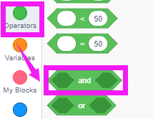
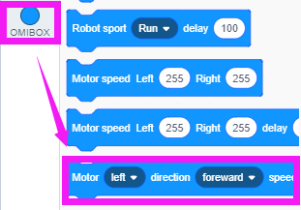
4
Search for blocks
The following is the location of the building blocks required for this programming.
Yahboom Omibox Tutorial

Slide 10
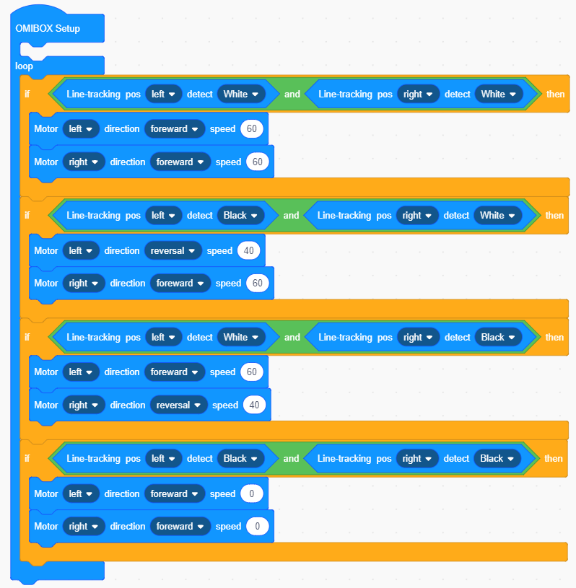
5
Combine blocks
The summary program is shown below:
Yahboom Omibox Tutorial

Slide 11
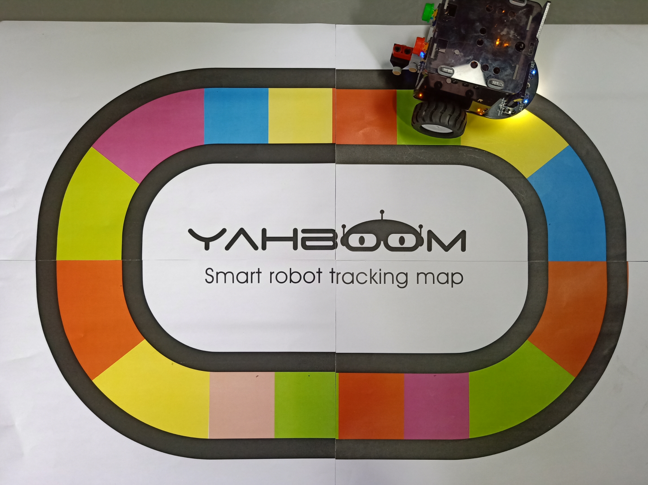
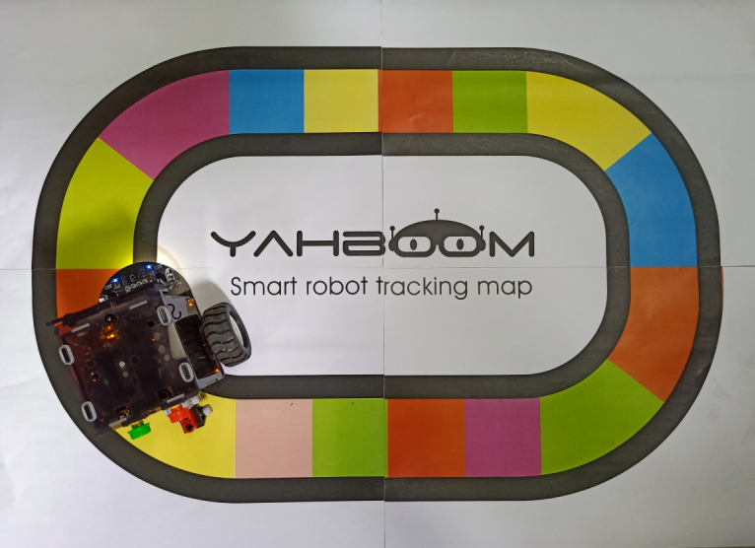

6
Experimental phenomena
After the program is uploaded, make the Omibox on the black track on the white background, or use our color track directly and open the power of the Omibox. We can see that the car will advance along the black track.
For the tracking sensor, except for black, other colors of the material cannot absorb the infrared light emitted by the infrared emission tube, so when the tracking probe detects the color track, it is equivalent to recognizing the white color. Tracking experiments can be completed.
Note:In order to avoid the interference of sunlight on the infrared light, the experiment must be carried out indoors！
Yahboom Omibox Tutorial

Slide 12
Inspire Creativity Embrace Innovation
Thank you!!!
Yahboom

